Slide 1
CONAN: A Practical Real-time APT Detection
System with High Accuracy and Efficiency
Chunlin Xiong, Tiantian Zhu, Weihao Dong, Linqi Ruan, Runqing Yang, Yueqiang Cheng, Yan
Chen, Fellow, IEEE, Shuai Cheng, and Xutong Chen
IEEE TRANSACTIONS ON DEPENDABLE AND SECURE COMPUTING 2019
Notes:
1.which code is executed
where it comes from
how it is executed.
2.ALERT: Suspicious code source
Suspicious behaviors
Network connections
features
因為holmes的phase可能太多 定義如何發出alert

Slide 2
Outline
Introduction
A Living Example And Threat Model
Detection Model
State-Based Framework
Evaluation
Discussion
Conclusion

Slide 3
INTRODUCTION
Traditional intrusion detection methods can be divided into two categories: offline and online.
Offline
Although sandbox approach and Provenance Graph allow a clear view of the attacks, considering the hysteresis of offline detection, people have begun using on line detection methods to detect attacks in real-time.
Online
Network traffic-based analysis, software static feature detection, and hook technology, focused mainly on one specific stage of APTs and the intrinsic mechanisms and attack vectors of APTs remain poorly understood.
Notes:
滯後性（Hysteresis）
Online只能看到單一現象，無法得知APT的資訊

Slide 4
INTRODUCTION
StreamSpot
analyzed streaming information flow graphs to detect anomalous activities by extracting local graph features and vectorizing them for classification.
Furthermore, these detection systems cannot detect attacks without false alarms.
Sleuth
proposed a tag-based detection method based on provenance graphs
but this method focused mainly on suspicious access to confidential files and reduced false positives by adding a domain white list.
Holmes
achieved substantial progress in phase-based detection by building a model that detected each phase based on simple rules and computed suspicious scores.
However, these phases are not all necessary in APT attacks
Notes:
StreamSpot 會有False-alarms的問題 而且無法解釋原因
Sleuth 用規則去給tag來降低誤報率，不僅維護成本高且容易被繞過。
Holmes 把每個phase detection都顧到了 但是不是每個phase在APT中都存在
為了更全面地理解 APT，安全分析師開始將 APT 的生命週期拆解成多個階段（例如 7 個或 11 個階段，即我們熟知的 MITRE ATT&CK 模型基礎）。這成為了目前主流的研究方向，也就是嘗試在攻擊的各個階段去比對對應的特徵。

Slide 5
INTRODUCTION
To address these challenges, especially, accuracy and efficiency, this paper presents a model for accurately detecting APTs.
Furthermore, it presents a novel state-based detection framework in which each process and file is represented as a fine-designed data structure for real-time, long-term detection.
We identify the following three essential attack phases:
deploy and execute the attacker’s code
collect sensitive information or cause damage
communicate with the C&C server or exfiltrate sensitive data.
Notes:
為了解決準確度問題，CONAN 捨棄了去追蹤那些容易改變、不必要或難以偵測的攻擊階段。 (APT的重點)
利用「控制流（解釋程式或程式碼為何被執行）」與「資料流（解釋資料如何在物件間傳遞）」來解析上下文行為 。
部署並執行攻擊者的程式碼。
收集機敏資訊或造成破壞。
與 C&C 伺服器通訊或外洩機敏資料。

Slide 6
A LIVING EXAMPLE AND THREATMODEL
In our threat model, an attacker knows his target well and prepares a new attack including zero-day vulnerabilities, self-developed malware and a new DNS.
Finally, if he wants to obtain sensitive information, these stolen data should be sent via network.
However, we cannot detect side-channel attacks and insider attacks, in which the attack has legal ways to access the machines. And Return-Oriented Programming (ROP) attack
All attacks used in the evaluation cannot be detected by traditional anti-virus systems.
As a result, pre-installed malware and malicious code can be detected.
Notes:
在我們的Threat Model裡面 攻擊者非常了解受害者並且準備進行零日攻擊，自我製造的malware和一個新的DNS。
在攻擊者獲得資料後必須透過網路回傳
但我們不能偵測side-channel attacks and insider attacks 因為這種攻擊具有正當的管道進入系統。以及 ROP 攻擊(利用stack overflow把惡意程式寫入緩衝區)會挾持程式的呼叫堆疊（Call stack）來控制程式流程 。但他們不會寫入新的惡意程式碼。(雖然 CONAN 抓不到 ROP，但學界和業界已經有很多現成的成熟方法可以有效避免或偵測 ROP 攻擊)
所有的在evaluation裡的攻擊都無法被傳統的防毒抓到，總結預安裝的malware和惡意code可以被偵測到(因為他們CONAN會抓控制流和資料流)

Slide 7
DETECTION MODEL - Motivation - “A”PT
An overly complicated multiphase model can be used only to better understand APTs, not to detect them.
In each attack chain, the more phases detected, the greater possibility of an attack.
However, there are three main problems.
First, there are hundreds of techniques used in each phase. This system must detect hundreds of techniques, which is hard to implement and can cause high detection overhead.
Second, the detection points of traditional methods, e.g., vulnerabilities, are still considered. (Prior Knowledge is needed)
Finally, the authors believe that although they cannot detect all phases accurately, as a subset of all phases, the detected ones are enough to distinguish attacks from benign activities.
Notes:
過於複雜的模型只適合用來事後理解或分析 APT，而不適合直接拿來做即時偵測。
例如，像 Holmes 這樣的指標性系統試圖去比對並偵測各個階段中的數百種微觀技術，並嘗試用資訊流將它們串聯成完整的攻擊鏈 。這種做法帶來的第一個致命傷就是實現難度極高，且會產生巨大的系統運算開銷
第三個問題則是引入了太多不必要且常見的階段，導致誤報率（False alarm rate）飆升 。
作者舉例，當使用者在主機上合法安裝一個全新的瀏覽器時，這個完全良性的行為在複雜的模型中會同時觸發多達 6 個攻擊階段（包含初始存取、執行、持久化、憑證存取、發現和外洩），這會直接導致 Holmes 系統將其誤判為惡意攻擊並發出假警報 。

Slide 8
DETECTION MODEL - Three-phase Detection Model
APT attacks can first be observed that attackers must first deploy their code to victims. The difference is that malware may be customized or executed only in memory to evade traditional static file based detection systems.
The second observation is that the final targets of attackers remain the same over the years.(APT1 & APT38) : APT1 attacks to steal hundreds of terabytes of data; APT38 attacks to achieve privacy leakage or damage.
The final observation is that attackers will communicate with C&C servers and exfiltrate confidential data, and the malicious program should always have the ability to access the network.
Notes:
一定會在受害者主機deploy code，或是memory attack (可以抓控制流)
APT一定是偷資料回傳以及破壞系統 (抓控制流)
一定是透過網路回傳 (抓資料流)

Slide 9
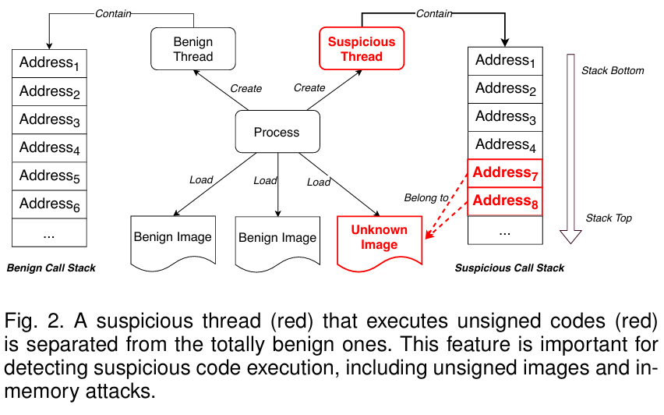
DETECTION MODEL - Tracking Suspicious Code Execution
If an attacker wants to execute malicious behaviors, he must:
1. execute malicious code directly or
2. achieve it with the help of benign processes.
The main challenges for detection are to determine
1. which code is executed
2. where it comes from
3. how it is executed.
control flows
coarse-grained data flows
Call Stacks
State-based
Inference Rules
Notes:
堆疊中的位址代表了不同程式碼區塊（如映像檔）的返回位址 。如果堆疊裡的位址全來自可信的區塊，就代表該執行緒很乾淨 。因為良性行程很容易被迫執行外部程式碼，CONAN 將行程往下拆解成更小的「執行緒（Threads）」單元來獨立檢視 。一旦發現執行緒在跑未知或可疑的程式碼，就會將其與完全良性的執行緒徹底隔離開來，進行獨立監控 。

Slide 10
DETECTION MODEL - Tracking Suspicious Code Execution
Image Load and Memory Execution
An attacker can replace benign image files with malicious ones or force a benign application to load a malicious image.
write malicious code directly into another process’s memory space or load an image from the memory
Script Execution
enumerates most of the common script hosts and treats them separately from normal processes.
Call Stacks
Notes:
映像檔載入與記憶體執行：攻擊者常透過替換良性映像檔，或強迫良性應用程式載入惡意映像檔來發動攻擊 。更進階的做法是「行程注入（Process injection）」（直接將惡意程式碼寫入其他行程的記憶體），或是「反射載入（Reflective loading）」（不觸發系統事件，直接從記憶體載入映像檔） 。
解法：系統會動態監控映像檔的載入，並把每個行程配置的記憶體基底位址與大小記下來 。只要呼叫堆疊裡出現了「未簽署映像檔」或「動態配置記憶體」的位址，系統就知道該執行緒被污染了，立刻將其隔離 。為了顧及效能，系統只對執行緒進行低頻率的抽樣檢查 。
腳本執行 (Script Execution)：近年來駭客愛用 PowerShell 等良性程式來「讀取」並執行惡意腳本，而不是傳統的「載入」 。
解法：系統會列舉出作業系統中常見的腳本宿主程式，並將它們與一般常規行程分開，採取特殊的監控策略 。

Slide 11
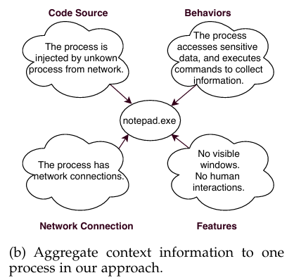
STATE-BASED FRAMEWORK - A“P”T
Each instance of processes and files is analogous to a set of automata
First, formulate the notions of semantic recognition, data structure, state transition condition and malicious state.
Next, we explain the method of reconstructing attacks based our framework.
Notes:
成本太高：目前已知的持久化技術多達 59 種，要全部監控的代價非常昂貴 。
無法證明是惡意：就算你抓到一個程式具有「持久化」特徵，也不能直接斷定它是惡意軟體，因為很多合法的軟體也會設定開機自啟動 。
時間差的偵測難題：高階攻擊者可以潛伏極長的時間而不做任何可疑行為 。一個惡意檔案可能在被下載的幾天後才被打開 。這種巨大的時間跨度，讓基於上下文資訊的偵測變得非常困難 。 既然不能把所有的歷史軌跡都畫成一張越來越大的圖，CONAN 提出了全新的解法：
引入自動機概念：作者提出了一個「基於狀態的框架 (State-based framework)」 。在這個框架下，每一個行程與檔案的實例，運作起來就像是一組「自動機 (Automata)」 。
狀態聚合取代歷史軌跡：系統不再記錄冗長的依賴路徑，而是將所有有助於偵測的上下文資訊，全部「聚合 (Aggregating)」成這個行程當下的「狀態」。
低開銷與高即時性：這種設計讓系統可以在極低的開銷下即時偵測不同的攻擊場景 。接下來的章節，作者將會具體定義這個框架的實作細節，包含語意識別、資料結構、狀態轉換條件、惡意狀態，以及如何用這個框架來重建攻擊 。

Slide 12
STATE-BASED FRAMEWORK - Semantic Recognition
Our semantic state definition is inspired by forensic analysis We call such semantics Atomic Suspicious Indicators (ASIs).
An ASI includes one of the following types of semantics, and is detected or inferred by corresponding traces:
1. The behaviors an attacker performs to achieve its target. Often detected by APIs or inferred by confidential data flows.
2. The source of suspicious codes, in other words, the reasons why a process can execute such behaviors; inferred by untrusted data flows.
3. The ability to conduct external communications, inferred by network activities.
4. The reasons why a process is executed inferred by untrusted control flows.
5. Additional features that describe the attack.
Notes:
可疑程式碼來源 (Code Source)：追蹤行程為何能執行這些行為，通常由「不可信資料流」或「不可信控制流」推論而來。
惡意行為 (Behaviors)：攻擊者為了達成破壞或竊密所執行的具體動作。
網路連線 (Network Connections)：具備對外通訊的能力。
附加特徵 (Features)：用來輔助說明不同攻擊場景的其他屬性（例如：該行程是否有使用者介面）。

Slide 13
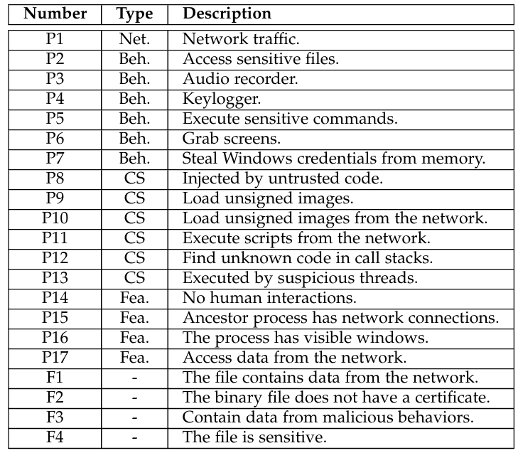
STATE-BASED FRAMEWORK - Semantic Recognition
Each ASI can be described as a triad: 〔No,Ty,De〕
No represents its position in a bitmap to record states.
Ty represents the categories
Suspicious code source
Suspicious behaviors
Network connections
features
De represents the descriptions used to explain the detection results in human-readable semantics.
process (P), file (F). code source (CS), behavior (Beh.), feature (Fea.), and network (Net.).
Notes:
可疑程式碼來源 (Code Source)：追蹤行程為何能執行這些行為，通常由「不可信資料流」或「不可信控制流」推論而來。
惡意行為 (Behaviors)：攻擊者為了達成破壞或竊密所執行的具體動作。
網路連線 (Network Connections)：具備對外通訊的能力。
附加特徵 (Features)：用來輔助說明不同攻擊場景的其他屬性（例如：該行程是否有使用者介面）。

Slide 14
STATE-BASED FRAMEWORK - Semantic Recognition
These ASIs are recognized by direct extraction from source data or inferred through rules. A new ASI that can aid in the detection of APTs should be declared if
it has different semantics than those of existing ASIs or
there are multiple ways to recognize the same semantics with different accuracy
Although the behaviors that are usually performed by attackers are among the most important ASIs, there is no mature method for detecting them.
To balance the accuracy and efficiency, we manually generated a set of topology API signatures to recognize these behaviors based on their code implementations
Notes:
只要出現既有ASI沒有的定義 或是 同一個語意具有不同的方式去辨識而且具有不同準確率(眾說紛紜) 就創一個新的ASI 偵測痛點：網路連線或檔案讀寫很容易用日誌推論，但要判斷一個程式是不是在「做壞事（如側錄鍵盤、偷截圖）」，卻缺乏成熟的方法。
為了克服這點，作者對過去十年內超過 50 個「遠端控制木馬（RAT remote access trojan）」家族、500 多份白皮書(white
papers)進行了大規模研究。他們發現一個驚人的事實：這些木馬為了達成特定目的，底層程式碼的實作方式幾乎是大同小異的。
拓撲 API 簽章：基於這個發現，作者手動建立了一套「API 拓撲簽章」。這就像是針對惡意行為畫出的「API 呼叫順序流程圖」（因為資料在 API 之間傳遞有固定的先後順序）。實驗證明，這種簽章的覆蓋率和真陽性率非常高（達到 90%）。

Slide 15
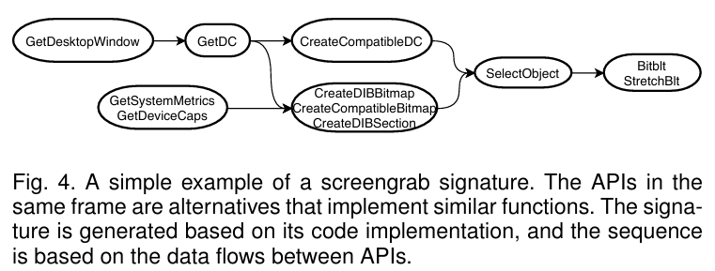
STATE-BASED FRAMEWORK - Topology API signatures
The coverage and true positive rate of API signatures are high (90%), but they may be ambiguous.
The APIs used to take screen shots are also used to draw pictures in windows; even the sequences remain the same.
we convert these topographies to FSAs to match signatures with streaming data, and these APIs should be matched in a window to reduce the false alarms.
We use ETW kernel call stack traces to recover the API calls.
Notes:
拓撲 API 簽章：基於這個發現，作者手動建立了一套「API 拓撲簽章」。這就像是針對惡意行為畫出的「API 呼叫順序流程圖」（因為資料在 API 之間傳遞有固定的先後順序）。實驗證明，這種簽章的覆蓋率和真陽(TP)率非常高（達到 90%）。
原意：圖 4 中，有時候同一個框框（Frame）裡會列出好幾個不同的 API（例如 BitBlt 和 StretchBlt 可能被放在一起）。
解釋：這代表駭客如果想完成「複製影像」這個動作，他可以呼叫 BitBlt，也可以呼叫 StretchBlt，這兩個 API 在功能上是可以互相替代的。CONAN 在設計簽章時，會把這些具有相同功能的替代 API 整理在同一個群組（框框）裡。這樣一來，不論駭客選擇用哪一個 API，系統都能成功比對到。
這個簽章是根據程式碼的實作方式生成的，而 API 之間的「順序（Sequence）」則是基於 API 之間的「資料流（Data flows）」。 這些行為的順序都是固定的 所以只要攻擊者做一樣的事就會被抓到。 像是在寫程式擷取螢幕時，你必須先取得螢幕的控制權（例如呼叫 GetDesktopWindow 和 GetDC），然後才能取得螢幕的長寬資訊（例如 GetSystemMetrics），接著建立一個用來存放影像的記憶體空間（例如 CreateCompatibleBitmap），最後才能把螢幕的影像複製進去（例如 BitBlt）。
ETW 會精準捕捉這個行為瞬間，並連帶記錄下當時的「核心呼叫堆疊 (Kernel call stack traces)」。CONAN 的底層收集器會拿著這些堆疊資料進行逆向解析，非常高效地「還原（Recover）」出該程式在使用者模式（User-mode）下到底是呼叫了哪一個高階 API。

Slide 16
STATE-BASED FRAMEWORK - Data Structure
Each process instance can be described as a quintuple:〔Na,Pi,Cl,Ui,St〕 which contains the basic information of a process.
Na is the process name
Pi is the process ID
Cl is the command line.
Na and Pi can be duplicated, we assign a unique ID (Ui) for each instance.
St represents the state of this process.
Each file instance is a triad: 〔Na,Ui,St〕
Na stands for file path
Ui is the unique ID
St is the state.
All inactive processes and files are removed from memory to the database to ensure the memory is constant.
Notes:
行程五元組 (Process Quintuple：$\langle N_a, P_i, C_l, U_i, S_t \rangle$)
$N_a$ (Name)：行程名稱。
$P_i$ (PID)：作業系統分配的行程 ID。
$C_l$ (Command Line)：啟動該行程的完整命令列參數（這對分析惡意行為非常重要）。
$U_i$ (Unique ID)：系統賦予的全域唯一識別碼，確保絕對定位。
$S_t$ (State)：最核心的狀態欄位。
檔案三元組 (File Triad：$\langle N_a, U_i, S_t \rangle$)
$N_a$ (Path)：檔案完整路徑。
$U_i$ (Unique ID)：全域唯一識別碼。
$S_t$ (State)：檔案的狀態欄位。
所有已經結束的行程或不再被操作的檔案（Inactive），都會被系統當作垃圾回收，立刻從主記憶體中「剔除」，並將其最後的狀態快取寫入資料庫中。

Slide 17
STATE-BASED FRAMEWORK - State Transition
To automatically distinguish between these events and record the semantics, we created a group of predefined rules to assign more detailed semantics to the events.
Each rule is a six-tuple: 〔No,Ss,Ev,So,Di,De〕
No is the serial number of the rule, which is used in an edge to represent how this operation is generated.
Ss stands for a specific state of a subject. A subject is always a process in our design.
So stands for a specific state of an object. An object is a process, a file or an IP.
Ev is the event performed by the subject on the object.
Di, forward or backward,indicates the direction in which one entity influences the other.
De is the description of the purpose of the rule

Slide 18
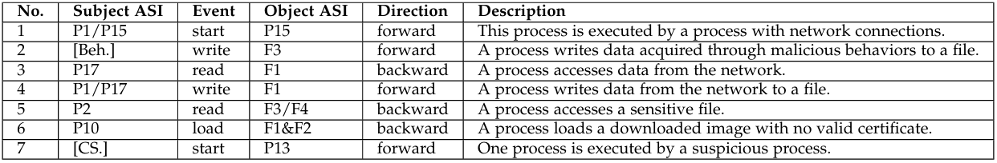
STATE-BASED FRAMEWORK - State Transition
Each rule is a six-tuple: 〔No,Ss,Ev,So,Di,De〕
No is the serial number of the rule, which is used in an edge to represent how this operation is generated.
Ss stands for a specific state of a subject. A subject is always a process in our design.
So stands for a specific state of an object. An object is a process, a file or an IP.
Ev is the event performed by the subject on the object.
Di, forward or backward,indicates the direction in which one entity influences the other.
De is the description of the purpose of the rule

Slide 19
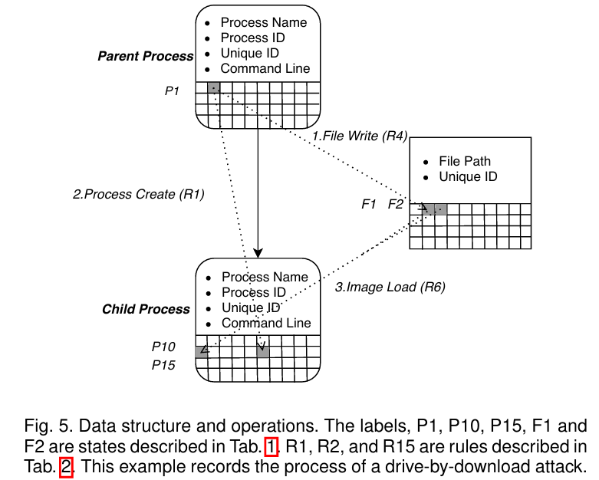
STATE-BASED FRAMEWORK - State Transition
Each entity in our system is like an FSA and can be described as a quintuple: 〔S,Σ,δ,S0,F〕
S: the set of states. The combinations of the bits in St,which represent the current states of processes and files.
Σ: the input alphabet. Consists of the system events Ev.
δ: the state-transition function.
δ: Sf ×Σ→Sl
Notes:
$S$ (狀態集合)：對應到實體的狀態位元圖（Bitmap）。
$\Sigma$ (輸入字母表)：系統中發生的各種事件（$E_v$），例如讀取、寫入、網路連線等。
$\delta$ (狀態轉換函數)：$\delta : S_f \times \Sigma \rightarrow S_l$。這是 CONAN 最特別的創新！傳統的 FSA 是指「同一個實體」隨著輸入改變自己的狀態；但在 CONAN 中，這個轉換是跨實體傳染的。一個事件（$\Sigma$）會讓來源實體的狀態（$S_f$）跑到另一個目標實體（$S_l$）身上。
$S_0$ (初始狀態)：當系統中出現新的行程或檔案時，它在記憶體中會被實例化，且所有狀態位元預設都是 false（全為 0）。唯一的例外是那些被系統管理員預先定義為機密目標的檔案，它們在誕生時就會被賦予 F5（包含機敏資料）的初始狀態。
$F$ (最終狀態/惡意狀態)：這代表了系統的底線。一旦一個行程的狀態位元圖不斷疊加，最終踏入了這個 $F$ 集合（即滿足了惡意狀態的條件），系統就會立刻觸發 APT 攻擊警報。

Slide 20
STATE-BASED FRAMEWORK - Malicious States
If a process contains at least one ASI from each of the first three categories (excluding features), we say it enters a malicious state.
all detection progresses can be performed by simply checking the state of
one process.
Note that we do not use any white lists of files, processes or domains, except code certification.
suspicious code sources
network connections
suspicious behaviors
features
Notes:
為甚麼沒Feature，因為前三者是構成 APT 攻擊「必不可少的實質動作」，而附加特徵（如是否隱藏視窗）只是用來輔助說明的屬性。

Slide 21
STATE-BASED FRAMEWORK - Attack Reconstruction
Because our system preserves the source of every ASI in a database as edges between states, finding the provenance of the attack can be accomplished in linear time by back tracking through edges.
For forward analysis, because our system can detect a malicious process immediately, nearly no additional impact can be inflicted by the suspicious process; thus, there is no dependency explosion for forward tracking.
Notes:
因為 CONAN 把所有的攻擊證據都濃縮成了行程當下的「狀態（ASIs）」，所以重建攻擊的根本邏輯就變成了：「去解釋這個行程為什麼會擁有這些惡意狀態？」。
這種只追蹤「狀態傳染路徑」的作法，讓系統能在 $O(N)$ 的線性時間內極速完成溯源，不需要去搜尋整顆硬碟的龐大日誌。
因為 CONAN 是一個「即時（Real-time）」偵測系統，惡意行程一滿足條件就會立刻被逮住並阻斷。它根本沒有時間和機會去感染其他無辜的檔案，因此在做前向追蹤時，自然就不會發生相依性爆炸。

Slide 22
EVALUATION - Implementation
We extend ETW by adding data sources, such as certificates of binary files, human interactions, and clipboards.
The data collector is implemented in C++ and consists of approximately 9.2-thousand lines of code (KLoC).
The remaining components are implemented in Java and consist of approximately 6.2 KLoC
All states, rules and malicious states are customizable and specified in configuration files of approximately 112 lines.

Slide 23
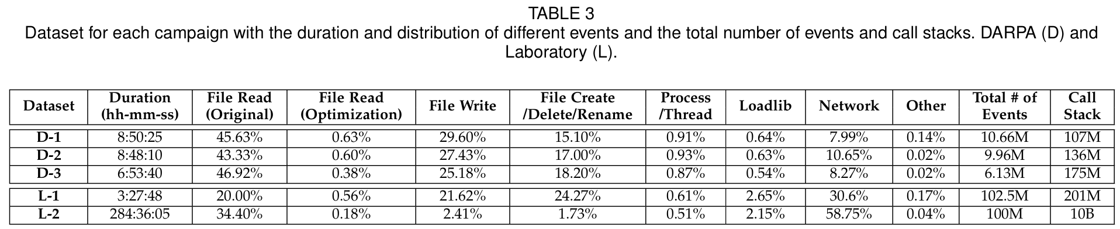
EVALUATION - Datasets
when a file is read by a process, the collector ignores duplicate read events between two adjacent write events because the states of this file can not be changed until it is written, and thus, the process will not be influenced by these read events.

Slide 24
EVALUATION - Environments and Experimental Setups
Laboratory
主機一 (L-1)：作者不僅在這台機器上投放了惡意攻擊，還刻意安裝了一堆「行為很像駭客工具」的合法軟體 。例如：TeamViewer、Photoshop、 PuTTY、 Skype 。為了嚴格測試 CONAN 會不會被這些合法特徵干擾而產生誤報。
主機二 (L-2)：讓系統在另一台主機上連續運作好幾週，單純為了驗證其「長期穩定性」與確保在日常使用下維持低誤報率 。
Darpa
三台 Windows 10 主機在完全盲測的情況下達到零誤報。
Real-World Enterprise
CONAN被獲准部署在三家真實公司的辦公室網路中，證明能在不與現有資安設備衝突的前提下，高效且穩定地長期運作 。
Notes:
能達成零誤報的部分原因是 DARPA 演練模擬的是嚴格的企業環境，沒有人會亂裝未簽署的軟體，降低了干擾源 ；且系統只重建「足以證明是攻擊」的證據，並未畫出所有的行為軌跡以避免圖形爆炸 。

Slide 25
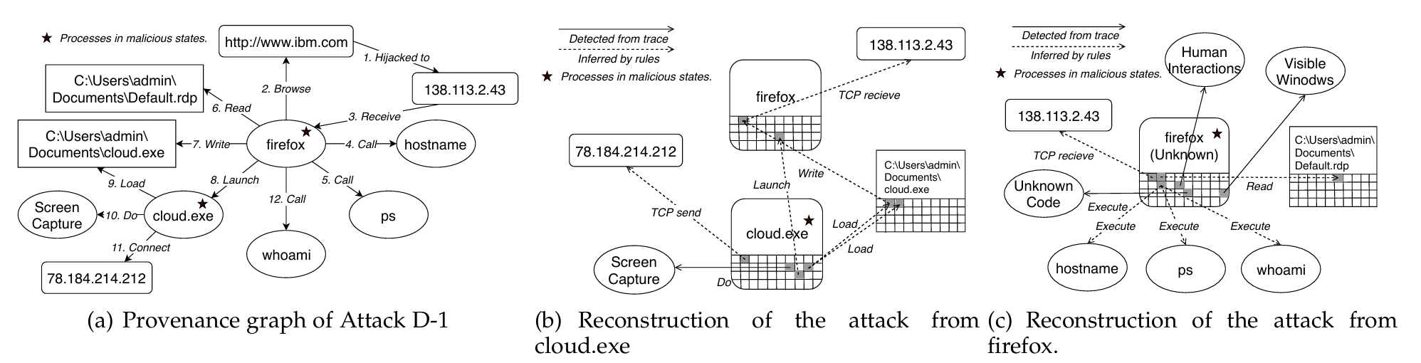
EVALUATION - Attack Scenarios and Reconstruction
Notes:
步驟 1：初始網路連線
使用者瀏覽了被駭客挾持的網站，導致 firefox.exe 連線到惡意 IP (138.113.2.43)。此時 CONAN 給 Firefox 貼上 P1 (具備外部網路連線) 的標籤。
步驟 2：漏洞利用與無檔案注入 (記憶體攻擊)
駭客利用 Firefox 的漏洞，直接在遠端讓 Firefox 執行未知程式碼。
CONAN 透過動態呼叫堆疊檢查發現了異常，立刻將這個「被污染的執行緒」與 Firefox 其他正常的執行緒隔離，並貼上 P12 (在呼叫堆疊中發現未知代碼) 的標籤。
步驟 3：展開惡意行為
這個被隔離的惡意執行緒開始執行系統指令 (hostname, tasklist) 並讀取機密檔案 (Default.rdp) 來收集主機情報。
CONAN 記錄下它 執行敏感指令 (P5) 與 存取機密檔案 (P2) 的行為。
步驟 4：第一次警報 (惡意狀態達成)
此時，這個執行緒集齊了「三位一體」：網路(P1) + 程式碼來源(P12) + 惡意行為(P2/P5)，CONAN 瞬間觸發警報。
透過分析附加特徵（它有可見視窗且有人類互動，代表這原本是個正常軟體），系統將這個階段的攻擊判定為 「合法應用程式的漏洞利用 (Exploitation of a benign application)」。
步驟 5：下載惡意酬載 (Payload)
Firefox 接著下載了一個名為 cloud.exe 的二進位檔案。這個檔案立刻被系統貼上 F1 (包含來自網路的資料) 的標籤。
步驟 6：執行惡意軟體與狀態繼承
Firefox 啟動了這個 cloud.exe。
根據狀態轉換規則，cloud.exe 一出生就繼承了可疑的血統：它被貼上 P13 (由可疑程序啟動) 以及 P10 (載入來自網路的未簽署映像檔) 的標籤。
步驟 7：第二次警報與資料外洩
cloud.exe 開始偷擷取螢幕畫面 (P6)，並將截圖發送到另一個全新的駭客 IP (78.184.214.212)。
因為它再次集齊了三大惡意條件，CONAN 觸發第二次警報，並將此場景判定為經典的 「下載並執行惡意軟體 (Download and execute malware)」。 階段一：精準捕獲「記憶體注入」 (零時差防禦)
行為：使用者以 Firefox 瀏覽網頁遭惡意 IP 挾持，利用漏洞執行遠端代碼。
CONAN 視角：偵測到網路連線 (P1)，並透過動態堆疊檢查發現異常，瞬間隔離惡意執行緒 (標記 P12)，完美破解傳統防毒最怕的記憶體注入。
階段二：觸發首次警報 (合法軟體遭利用)
行為：惡意執行緒開始探勘系統 (hostname) 並讀取機密檔 (.rdp)。
CONAN 視角：集齊「連線 + 來源異常 + 竊密行為」，達成三階段觸發條件，立即報警。並結合「具備可見視窗」特徵，判定為合法軟體遭挾持。
階段三：追蹤落地木馬與二次警報 (狀態繼承)
行為：Firefox 下載並執行實體木馬 cloud.exe，木馬開始截圖並外傳至新 IP。
CONAN 視角：cloud.exe 繼承「來自網路 (F1) / 可疑父行程 (P13)」標籤。當其執行截圖外傳時，再次觸發警報，判定為「下載並執行惡意軟體」。
階段四：高語意攻擊重建 (解決相依性爆炸)
摒棄傳統的流水帳記錄，系統透過回溯 ASI 標籤的傳染路徑，繪製出如圖 7(b)/7(c) 般清晰、無雜訊的攻擊軌跡圖，直接向資安人員解釋攻擊成因。

Slide 26
EVALUATION - Large-Scale Real-World Deployment

Slide 27
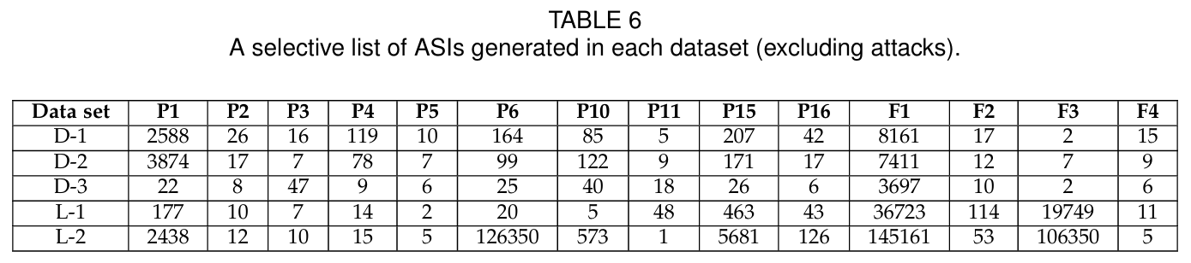
EVALUATION - False Alarms
Laboratory
安裝具備遠端控制特徵的合法軟體（如 Skype, TeamViewer）。
零誤報。證明系統能區分「功能需求」與「惡意意圖」。
Enterprise
約 80% 的「不可信資料流」其實來自企業內部網路 。超過 70% 的警報是由該領域的「客製化程式」觸發 。
破解版或重新封裝軟體行為模糊，增加判定難度 。
存取敏感資料
不可信資料流

Slide 28
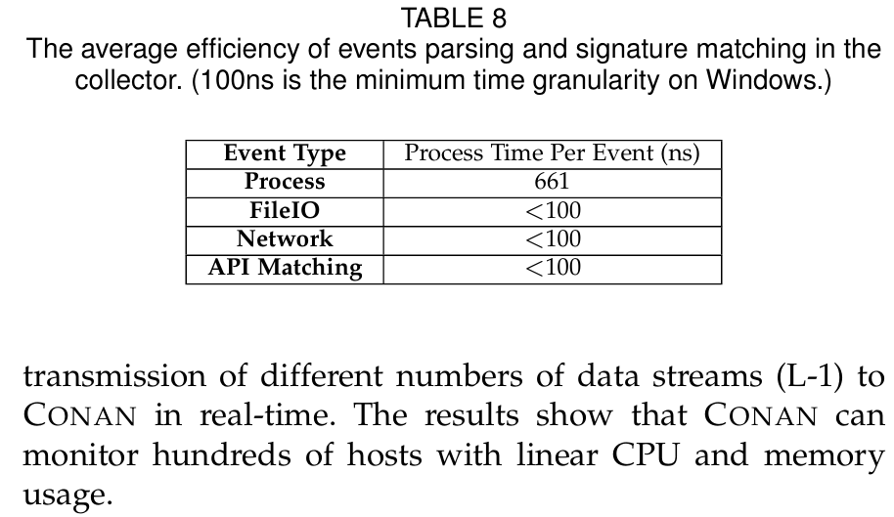
EVALUATION - Runtime Overhead and Memory Usage - collector
It can run on a host with Intel i5-7500 CPU (4 cores and 3.40 GHz) with less than 10 MB memory and 5% CPU usage.
Since 100ns is the minimum time granularity on Windows, the result shows that the collector can handle events and APIs efficiently.
The bandwidth usage is approximately 1-10 KB/s depending on the workload on the host.

Slide 29
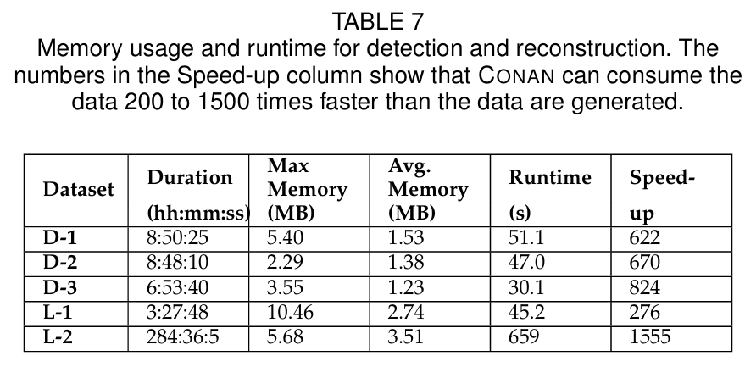
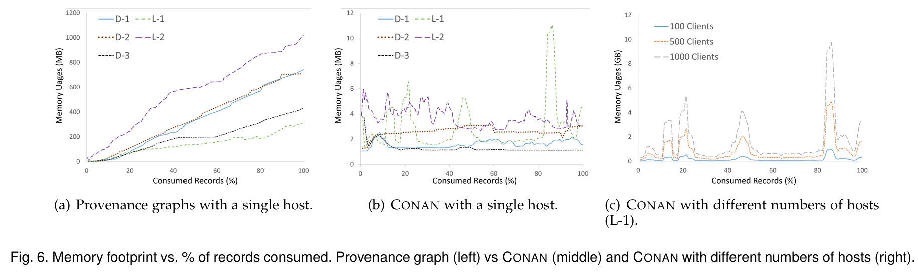
EVALUATION - Runtime Overhead and Memory Usage - detector
We set up the experiments on a server with an Intel Xeon Silver 4116 CPU (with 12 cores and 2.1 GHz of speed each) and 256 GB of memory running on Ubuntu18.04.
Each detector has constant memory, approximately 2.1 MB of memory on average.
Notes:
7a. 基於出處圖（Provenance Graphs）的系統（如文獻 [22]），在處理僅 5 天的資料集時，記憶體會從一開始的 100 MB 迅速飆升至 600 MB。

Slide 30
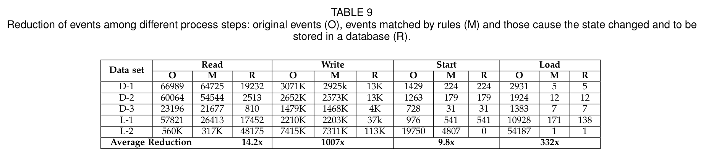
EVALUATION - Benefit of Semantic Recognition of Events
Since nearly 99.9% of system events are related to benign activities, it is very important to reduce irrelevant data to maintain the efficiency and accuracy of CONAN.
CONAN tracks most of the original events. The numbers in column M mean that less than 1% are stored for reconstruction. Duplicated Read events are prefiltered.

Slide 31
DISCUSSION
In-memory attacks
雖然無法防禦 ROP，但對於絕大多數需要進行 I/O 操作的 APT 攻擊，CONAN 依然具備強大的阻斷能力。
System Recovery
利用資料庫同步技術，確保系統在重啟後能 100% 回復記憶體狀態，防範潛伏期攻擊。
System Extension
針對 OS 底層行為設計簽章，以「有限的規則」應對「無限的變種」。
White Listing
引入 IP/行程白名單與更深層的記憶體認證機制，進一步壓低真實環境的誤報率。

Slide 32
CONCLUSION
We present CONAN, which provides efficient and accurate APT attack detection using an FSA-like state transition approach.
We identify the three most essential components of APT attacks to reduce false positives and false negatives, along with some designs to better recognize semantics.
we utilize states instead of a provenance graph to record semantics, which ensures constant memory usage over time.
During evaluation, with a well-designed detection model, CONAN detected all attacks rapidly with only one false alarm.

